Slide 1
GRAMMAR RANT
It’s no fun but it makes language work

Slide 2
Passive Voice
“The Pennsylvania System can be described as a system of solitary confinement.”
“The Pennsylvania System rested on a belief in the efficacy of solitary confinement in provoking rehabilitation.”
“Solitary confinement was the core feature of the Pennsylvania System.”

Slide 3
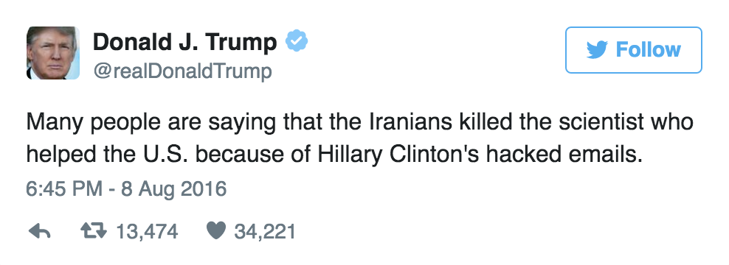
Many People Say
It is said that
It is believed to be
It can be conceived as

Slide 4
It is said becomes “The historian Stanley Wagstaff writes, …”
It is believed becomes “Many scholars believe that...”
It can be conceived as becomes “is,” as in “The Auburn System was a philosophy of punishment that embraced silence and labor as curatives.”

Slide 5
Wordiness
Never use more words when fewer words will do:
“The factor of incapacitation within the process of punishment can be acknowledged as a measure of preventing reoffending criminal behavior.”
Incapacitation prevents reoffending.

Slide 6
Introductions
Assume basic shared knowledge and avoid dictionary definitions
Don’t define “crime”
Define “punishment” only if the definition is important to your point
Avoid GARBAGE GENERIC PLACEHOLDERS such as “As long as the world has been here, there has been crimes and punishments.”
Everything you write needs to have purpose

Slide 7
Semi-Colons
Use RARELY
Not substitutes for commas
Use to separate closely related independent clauses
An independent clause can stand alone as a sentence
Why not just make it a separate sentence? Have a reason.

Slide 8
Comma Splices
Using a comma to connect two independent clauses rather than using a conjunction or a period.
“The purposes of criminal justice are many, they involve the protection of society, deterrence …”

